Slide 1
Syllabus
Data Warehousing Fundamentals
Introduction to Data Warehouse
Data warehouse architecture
Data warehouse versus Data Marts
E-R Modeling versus Dimensional Modeling
Information Package Diagram
Data Warehouse Schemas; Star Schema, Snowflake Schema,Fact Constellation Schema
Factless Fact Table
Update to the dimension tables.
Major steps in ETL process
OLTP versus OLAP
OLAP operations: Slice, Dice,Rollup, Drilldown and Pivot.

Slide 2
The need for Data warehousing
Operational computer systems (called online transactional processing system OLTP) did provide information to run day-to-day operations, and answer’s daily questions, but failed to provide strategic information
Data warehouse is a decision support database that is maintained separately from the organization’s operational database
Who needs strategic information in an enterprise?
The executives and managers who are responsible for keeping the enter-
prise competitive need information to make proper decisions
What exactly do we mean by strategic information?
Managers need information to formulate the business strategies, establish goals, set business objectives, and monitor results
some examples of business objectives:
Retain the present customer base
Increase the customer base by 15% over the next 5 years
Gain market share by 10% in the next 3 years
Improve product quality levels in the top five product groups
Enhance customer service level in shipments
Bring three new products to market in 2 years
Increase sales by 15% in the North East Division
‹#›
Notes:
‹#›

Slide 3
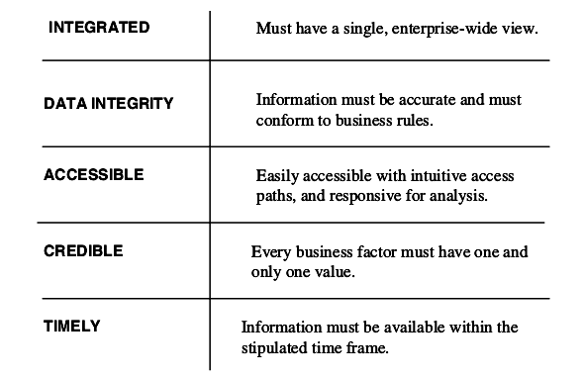
Characteristics of strategic information
‹#›
Notes:
‹#›

Slide 4
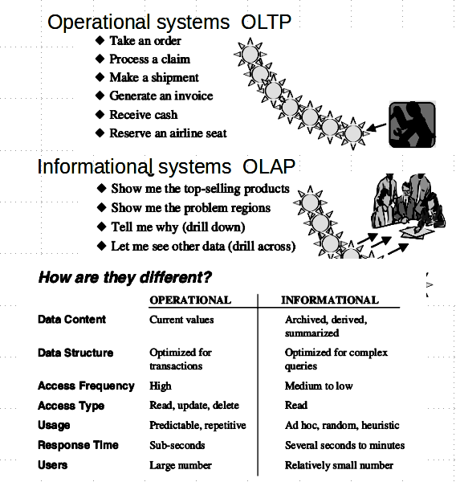
‹#›
Notes:
‹#›

Slide 5
What is Data Warehouse
•Defined in many different ways
–A decision support database that is maintained separately from the organization’s operational database
–Support information processing by providing a solid platform of consolidated, historical data for analysis.
•“A data warehouse is a subject-oriented, integrated, time-variant, and nonvolatile collection of data in support of management’s decision-making process.”—W. H. Inmon
•Data warehousing:
–The process of constructing and using data warehouses

Slide 6
Data Warehouse—Subject-Oriented
Organized around major subjects, such as customer, product, sales.
Focusing on the modeling and analysis of data for decision makers, not on daily operations or transaction processing.
Provide a simple and concise view around particular subject issues by excluding data that are not useful in the decision support process.
*

Slide 7
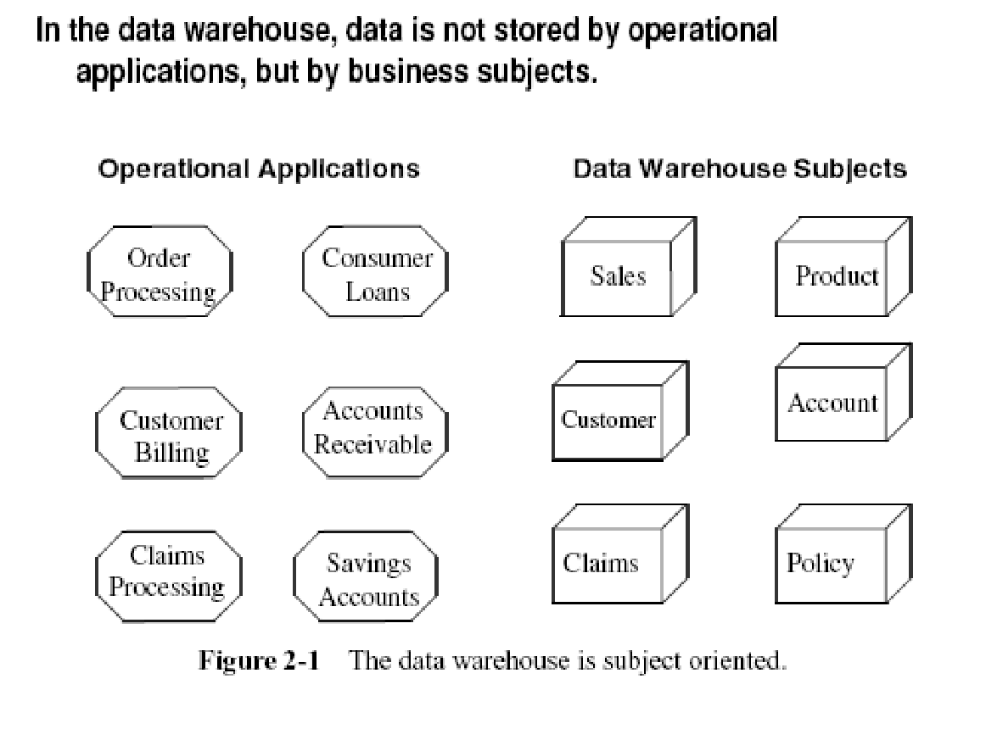
Data Warehouse—Subject-Oriented
Organized around major subjects, such as customer, product, sales.
Focusing on the modeling and analysis of data for decision makers, not on daily operations or transaction processing.
Provide a simple and concise view around particular subject issues by excluding data that are not useful in the decision support process.
*

Slide 8
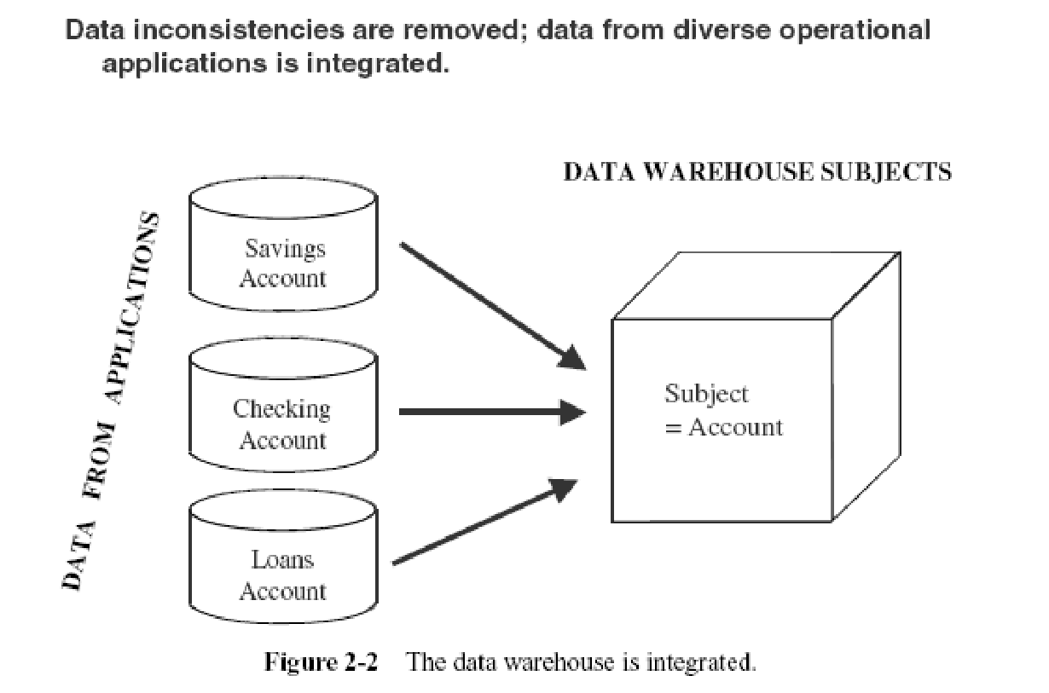
Data Warehouse—Integrated
Constructed by integrating multiple, heterogeneous data sources
relational databases, flat files, on-line transaction records
Data cleaning and data integration techniques are applied.
Ensure consistency in naming conventions, encoding structures, attribute measures, etc. among different data sources
E.g., Hotel price: currency, tax, breakfast covered, etc.
When data is moved to the warehouse, it is converted.
*

Slide 9
Integrated Data (2)
Before the data from various disparate sources can be usefully stored in a data warehouse, you have to:
remove the inconsistencies;
standardize the various data elements;
make sure of the meanings of data names in each source application.
‹#›
Notes:
‹#›

Slide 10
Integrated Data (3)
Before moving the data into the data warehouse, you have to go through a process of transformation, consolidation, and integration of the source data.
Here are some of the items that would need standardization:
Naming conventions
Codes
Data attributes
Measurements
‹#›
Notes:
‹#›

Slide 11
Data Warehouse—Time Variant
The time horizon for the data warehouse is significantly longer than that of operational systems.
Operational database: current value data.
Data warehouse data: provide information from a historical perspective (e.g., past 5-10 years)
Every key structure in the data warehouse
Contains an element of time, explicitly or implicitly
But the key of operational data may or may not contain “time element”.
*

Slide 12
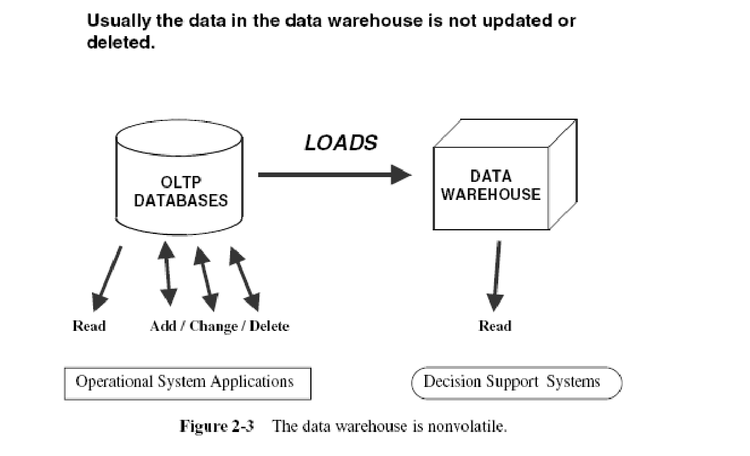
Nonvolatile Data
‹#›
Notes:
‹#›

Slide 13
Data Warehouse—Non-Volatile
A physically separate store of data transformed from the operational environment.
Operational update of data does not occur in the data warehouse environment.
Does not require transaction processing, recovery, and concurrency control mechanisms
Requires only two operations in data accessing:
initial loading of data and access of data.
*

Slide 14
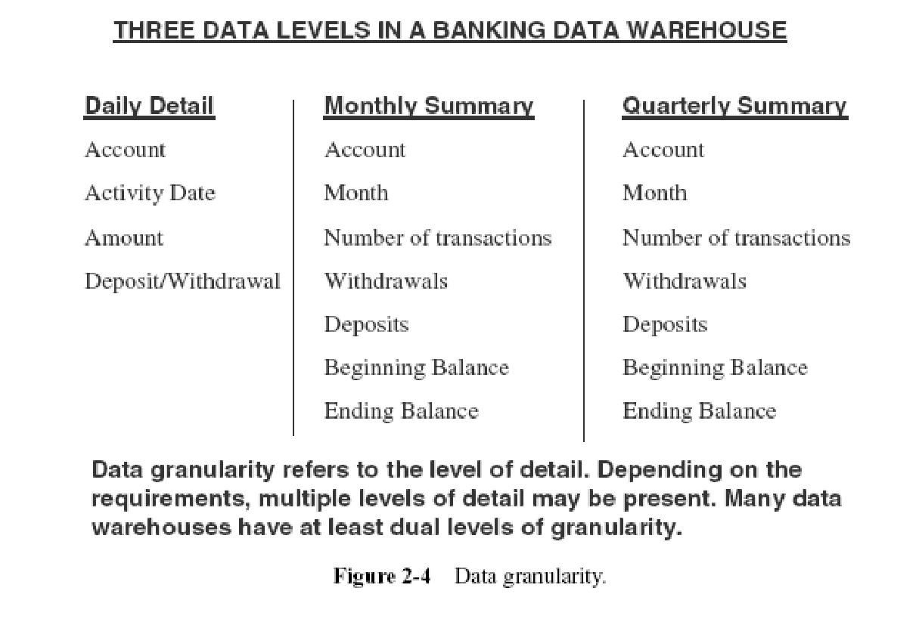
Data Granularity
‹#›
Notes:
‹#›

Slide 15
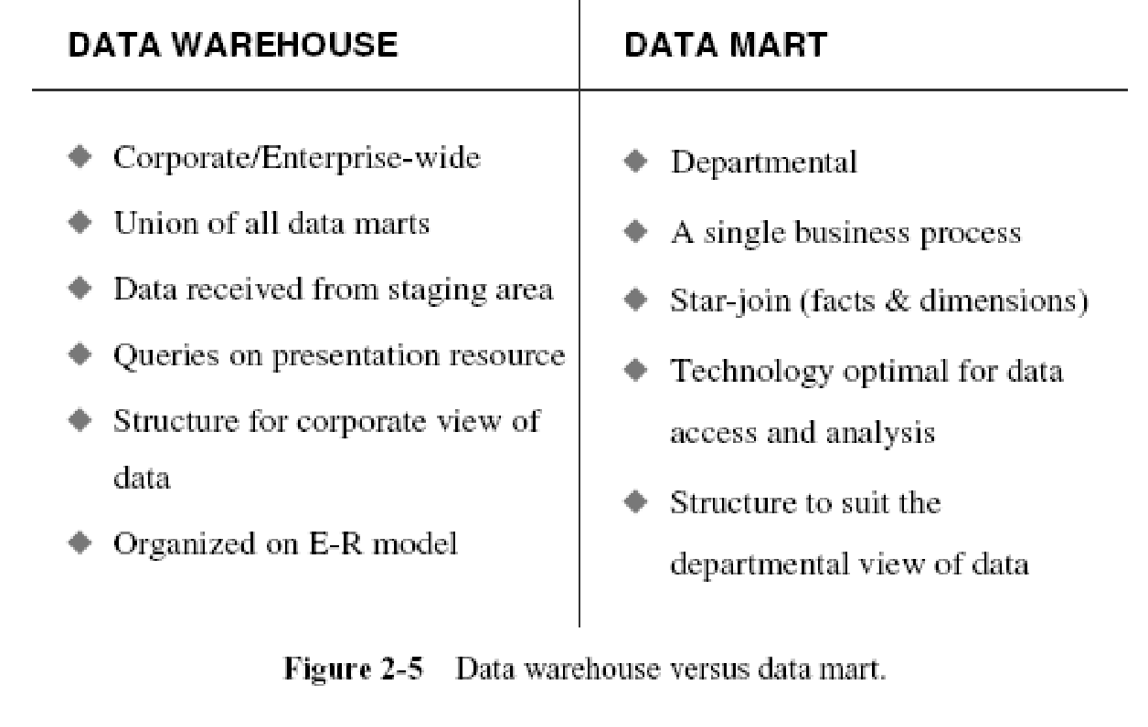
DATA WAREHOUSES AND DATA MARTS
‹#›
Notes:
‹#›

Slide 16
Data Warehouse vs. Operational DBMS
Distinct features (OLTP vs. OLAP):
User and system orientation: customer vs. market
Data contents: current, detailed vs. historical, consolidated
Database design: ER + application vs. star + subject
View: current, local vs. evolutionary, integrated
Access patterns: update vs. read-only but complex queries
*

Slide 17
Why Separate Data Warehouse?
High performance for both systems
DBMS— tuned for OLTP: access methods, indexing, concurrency control, recovery
Warehouse—tuned for OLAP: complex OLAP queries, multidimensional view, consolidation.
*

Slide 18
THE ARCHITECTURAL COMPONENTS
Notes:
‹#›

Slide 19
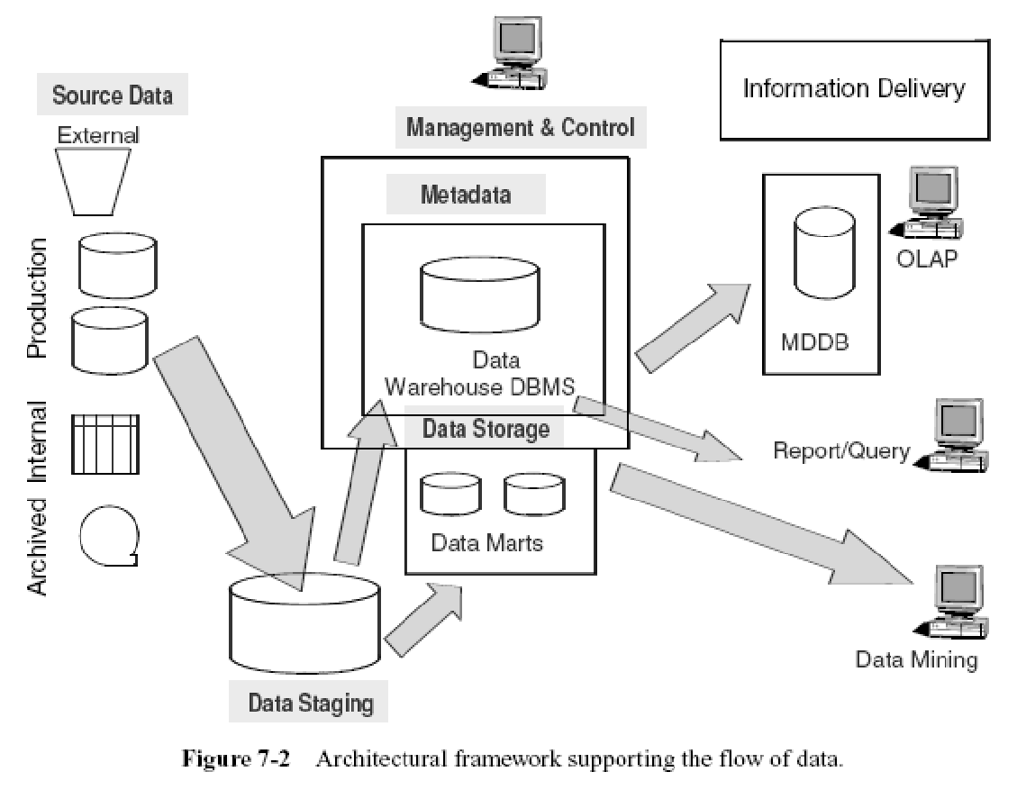
ARCHITECTURAL FRAMEWORK
‹#›
Notes:
‹#›

Slide 20
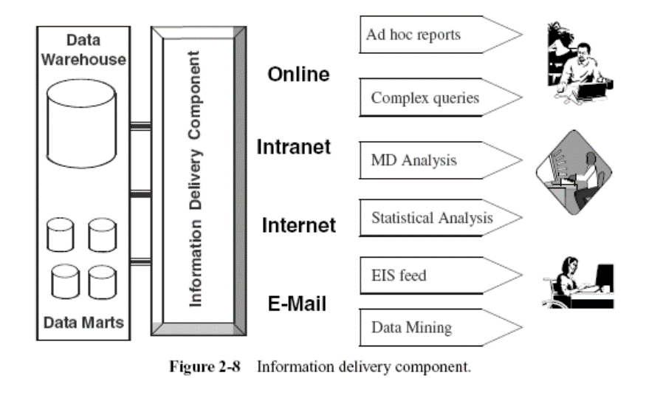
Components of data warehouse
Source data component
Production systems
Internal data (spreadsheets)
Archived data (tapes)
External data (stocks, interest rates, …)
Data Staging Component
Data Extraction.
Data Transformation.
Data Loading.
Management and Control Component
Data storage
Data mart
metadata
Information Delivery Component
-Adhoc reports
-Complex queries
-MD analysis
‹#›
Notes:
‹#›

Slide 21
ETL(Extract,transform,load)
Data Extraction
Select data sources and determine the types of filters to be applied to individual sources
Generate automatic extract files from operational systems using replication and other techniques
Create intermediary files to store selected data to be merged later
Transport extracted files from multiple platforms
Provide automated job control services for creating extract files
Reformat input from outside sources
Reformat input from departmental data files, databases, and spreadsheets
Generate common application code for data extraction
Resolve inconsistencies for common data elements from multiple sources
‹#›
Notes:
‹#›

Slide 22
ETL(Extract,transform,load)
Data acquisition covers the entire process of extracting data from the data sources, moving all the extracted data to the staging area, and preparing the data for loading into the data warehouse repository.
The two major architectural components are
-source data
-data staging.
‹#›
Notes:
‹#›

Slide 23
ETL(Extract,transform,load)
Data Transformation
Map input data to data for data warehouse repository
Clean data, deduplicate, and merge/purge
Denormalize extracted data structures as required by the dimensional model of the data warehouse
Convert data types
Calculate and derive attribute values
Check for referential integrity
Aggregate data as needed
Resolve missing values
Consolidate and integrate data
‹#›
Notes:
‹#›

Slide 24
ETL(Extract,transform,load)
Data Staging
Provide backup and recovery for staging area repositories
Sort and merge files
Create files as input to make changes to dimension tables
If data staging storage is a relational database, create and populate database
Preserve audit trail to relate each data item in the data warehouse to input source
Resolve and create primary and foreign keys for load tables
Consolidate datasets and create flat files for loading through DBMS utilities
If staging area storage is a relational database, extract load files
‹#›
Notes:
‹#›

Slide 25
ETL(Extract,transform,load)
Data storage covers the process of loading the data from the staging area into the data warehouse repository.
All functions for transforming and integrating the data are completed in the data staging area.
The prepared data in the data warehouse is like the finished product that is ready to be stacked in an industrial warehouse.
‹#›
Notes:
‹#›

Slide 26
ETL(Extract,transform,load)
List of Functions and Services
Load data for full refreshes of data warehouse tables
Perform incremental loads at regular prescribed intervals
Support loading into multiple tables at the detailed and summarized levels
Optimize the loading process
Provide automated job control services for loading the data warehouse
Provide backup and recovery for the data warehouse database
Provide security
Monitor and fine-tune the database
Periodically archive data from the database according to preset conditions
‹#›
Notes:
‹#›

Slide 27
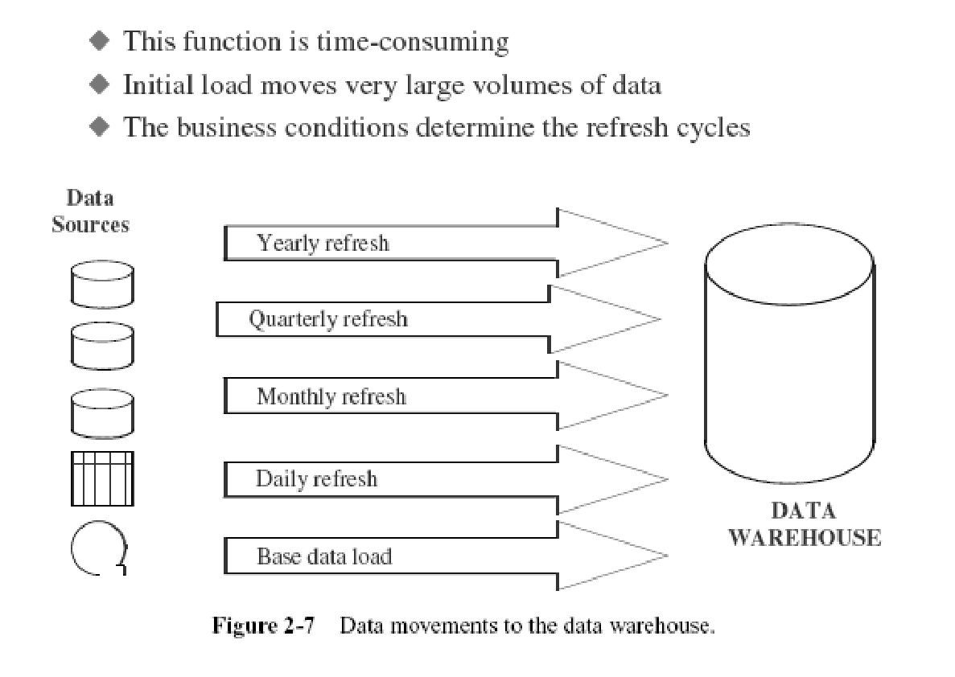
Data Movement to the data Warehouse
‹#›
Notes:
‹#›

Slide 28
METADATA IN THE DATA WAREHOUSE
Notes:
‹#›

Slide 29
WHY METADATA IS IMPORTANT
Users to compose and run the query can have several important questions:
Are there any predefined queries I can look at?
What are the various elements of data in the warehouse?
Is there information about unit sales and unit costs by product?
How can I browse and see what is available?
From where did they get the data for the warehouse? From which source systems?
How did they merge the data from the telephone orders system and the mail orders system?
How old is the data in the warehouse?
When was the last time fresh data was brought in?
Are there any summaries by month and product?
‹#›
Notes:
‹#›

Slide 30
Types of Metadata
Metadata in a data warehouse fall into three major categories:
Operational Metadata
Extraction and Transformation Metadata
End-User Metadata
‹#›
Notes:
‹#›

Slide 31
Operational Metadata
Data for the data warehouse comes from several operational systems of the enterprise.
These source systems contain different data structures.
The data elements selected for the data warehouse have various field lengths and data types.
In selecting data from the source systems for the data warehouse, you split records, combine parts of records from different source files, and deal with multiple coding schemes and field lengths.
When you deliver information to the end-users, you must be able to tie that back to the original source data sets.
Operational metadata contain all of this information about the operational data sources.
‹#›
Notes:
‹#›

Slide 32
End-User Metadata
The end-user metadata is the navigational map of the data warehouse. It enables the end-users to find information from the data warehouse. The end-user metadata allows the end-users to use their own business terminology and look for information in those ways in which they normally think of the business.
‹#›
Notes:
‹#›

Slide 33
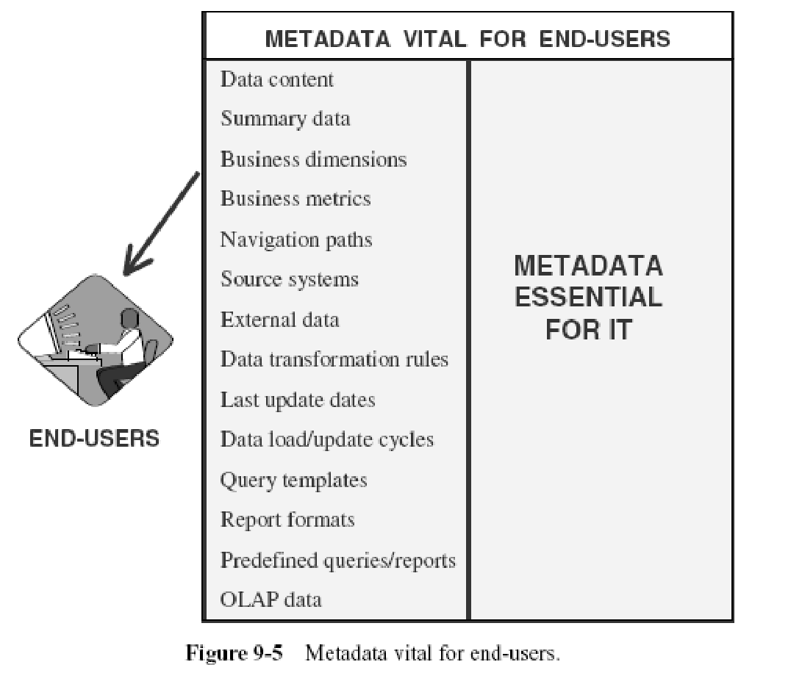
‹#›
Notes:
‹#›

Slide 34
Extraction and Transformation Metadata
Extraction and transformation metadata contain data about the extraction of data from the source systems, namely, the extraction frequencies, extraction methods, and business rules for the data extraction. Also, this category of metadata contains information about all the data transformations that take place in the data staging area.
‹#›
Notes:
‹#›

Slide 35
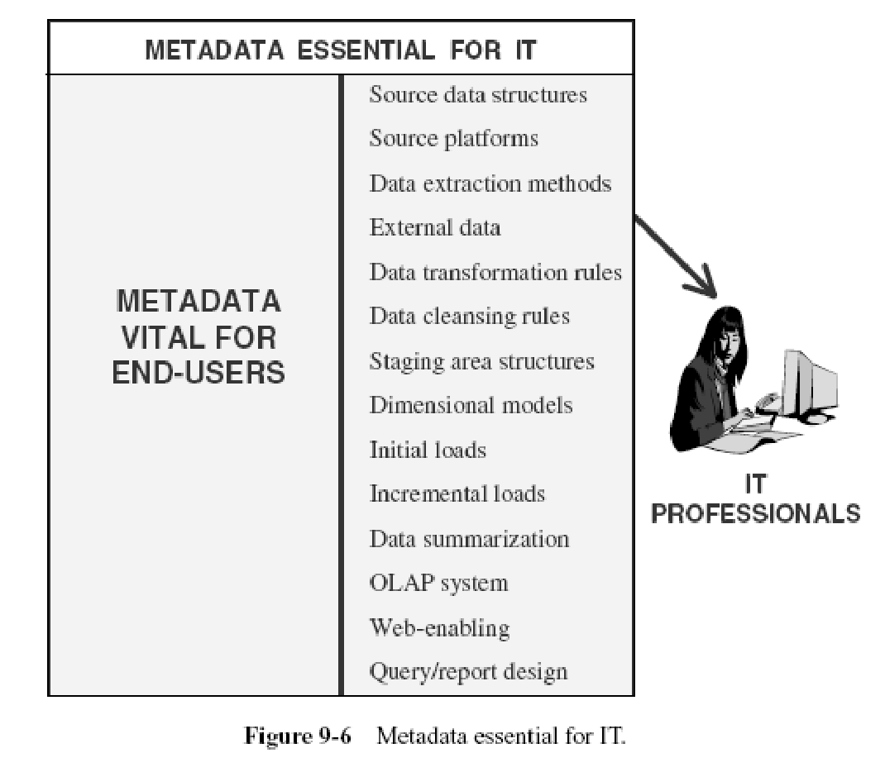
‹#›
Notes:
‹#›

Slide 36
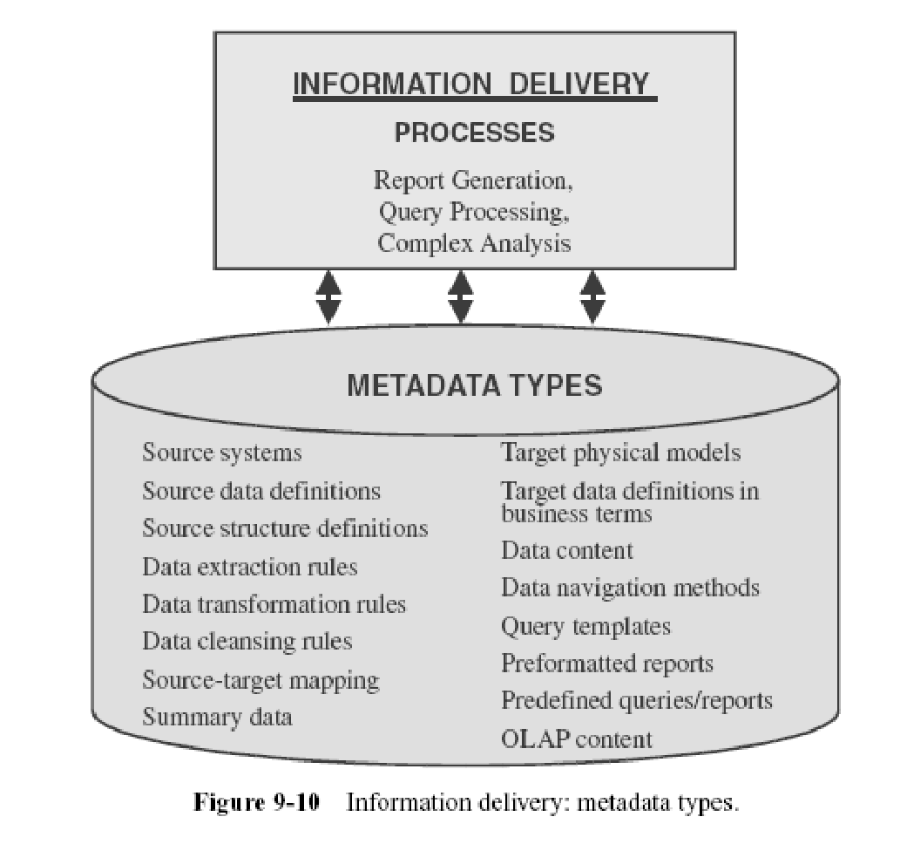
‹#›
Notes:
‹#›

